Slide 1
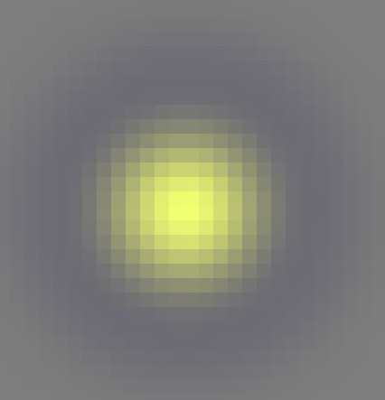


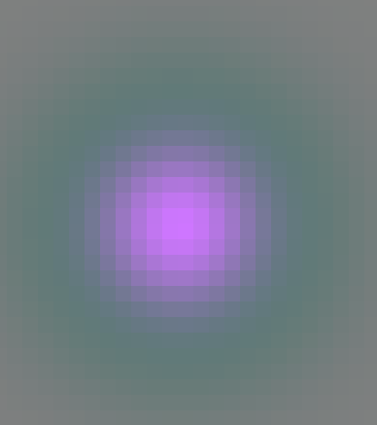
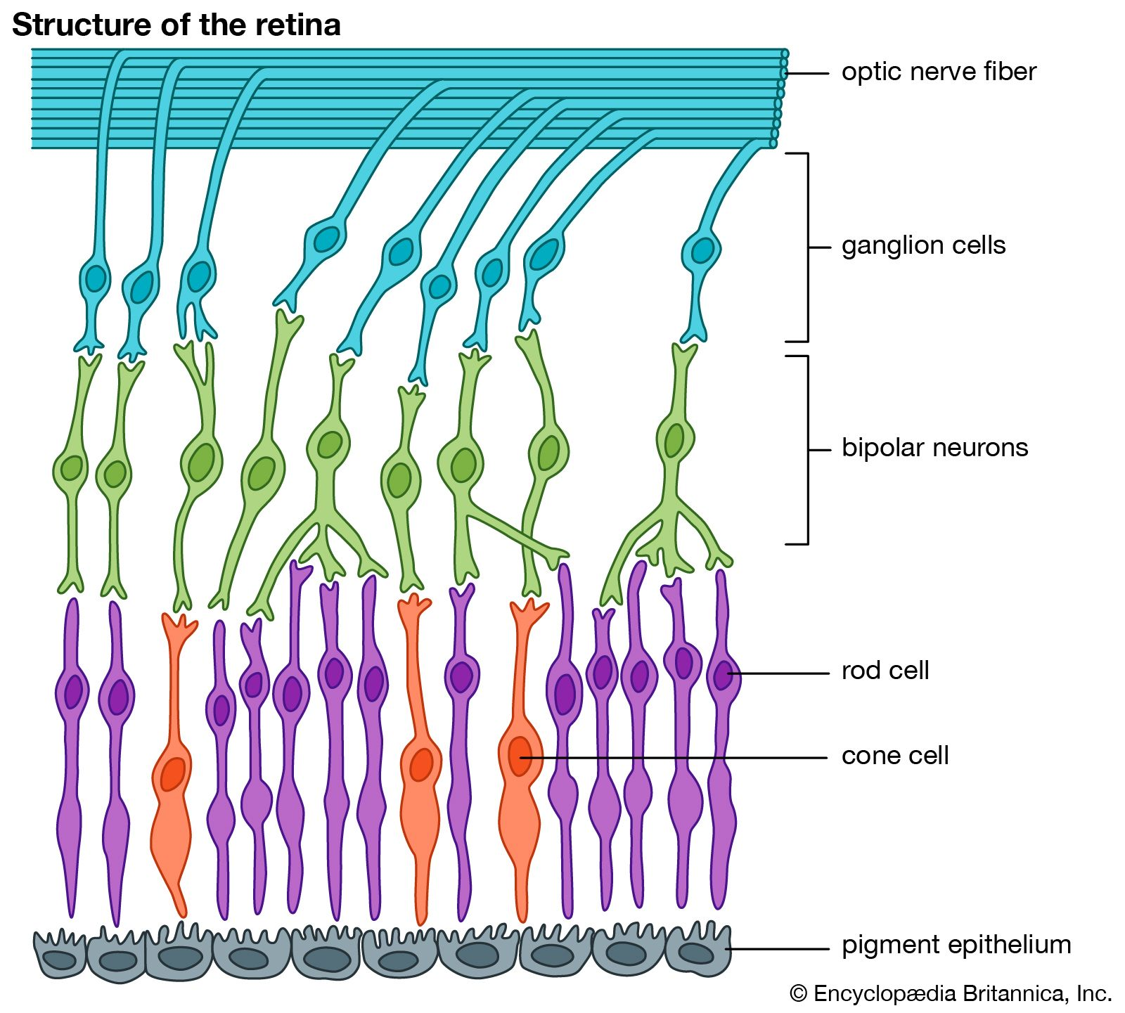
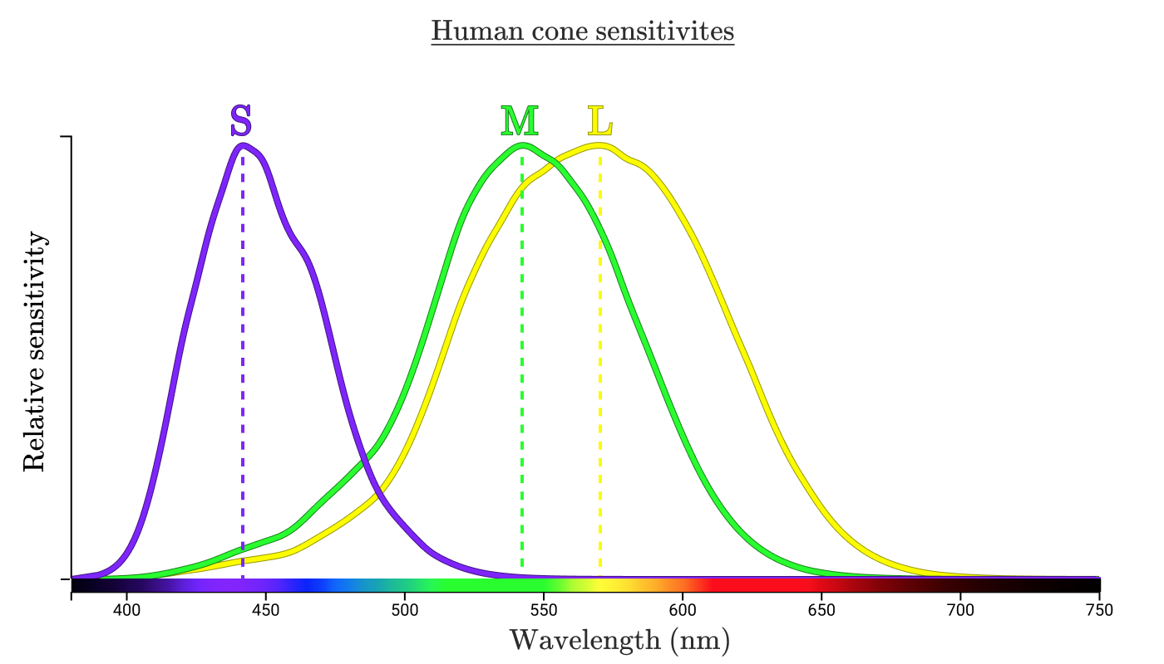
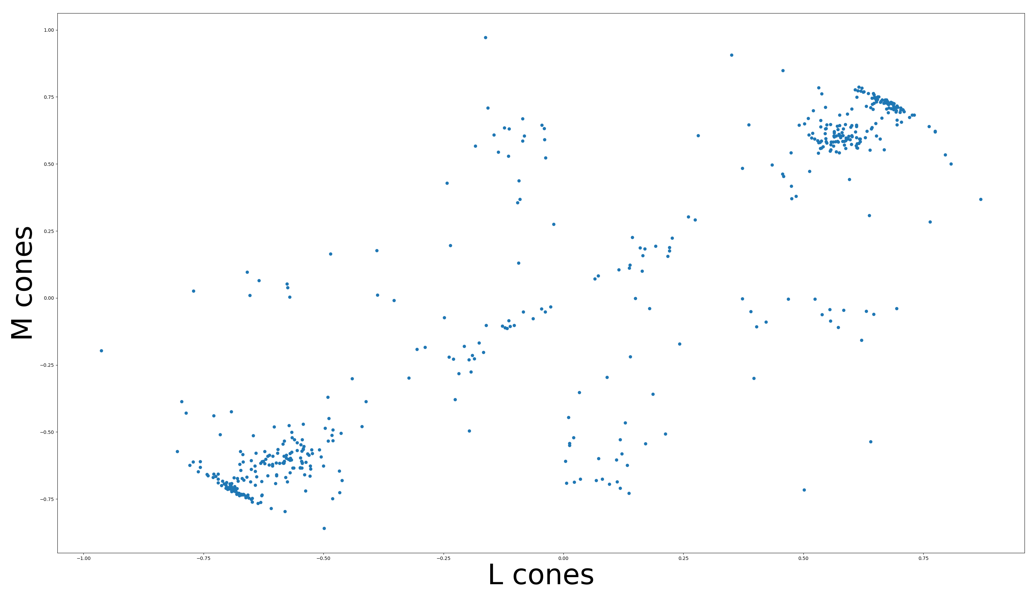
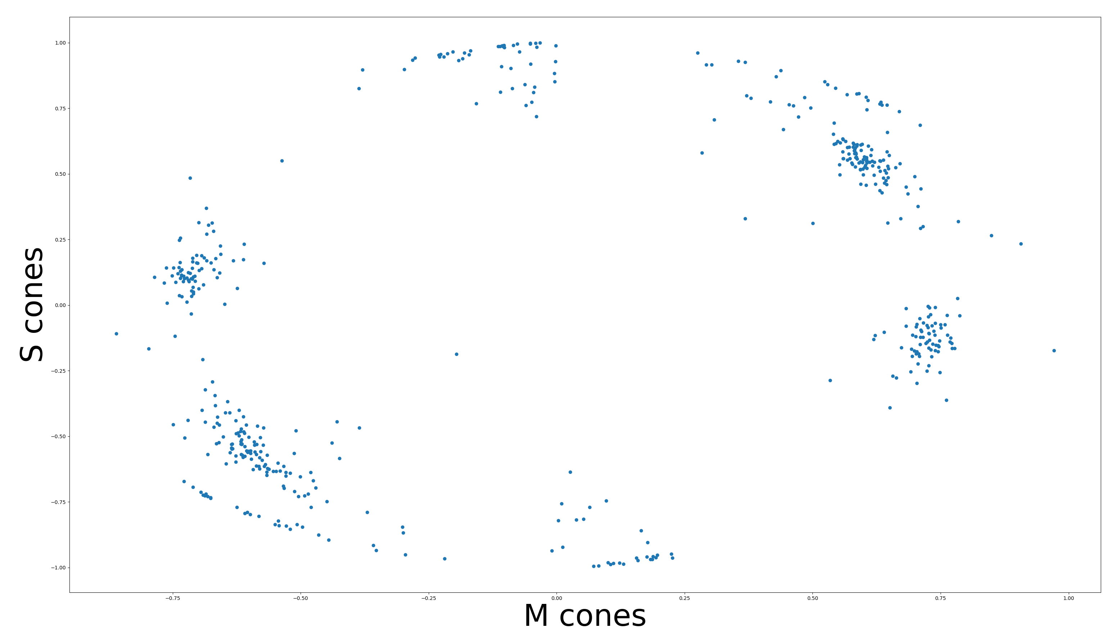
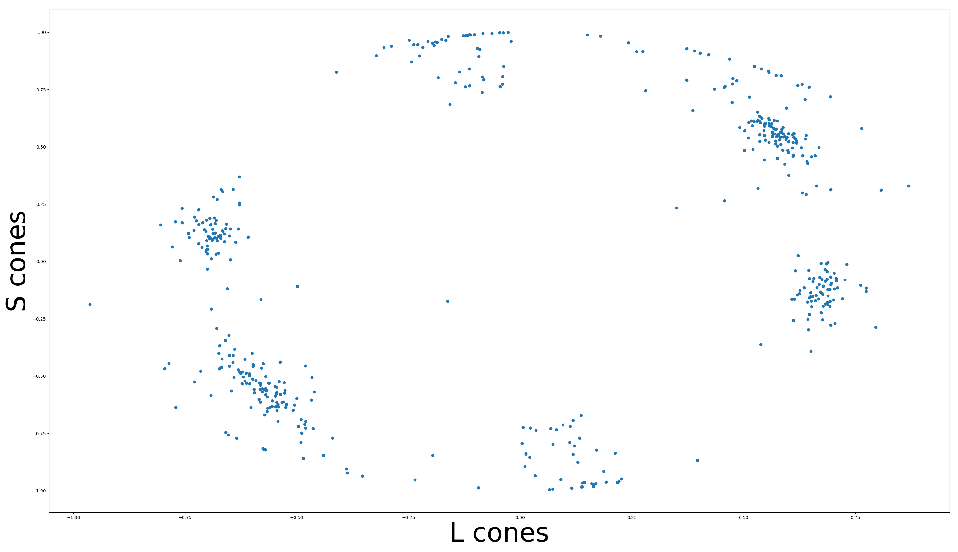
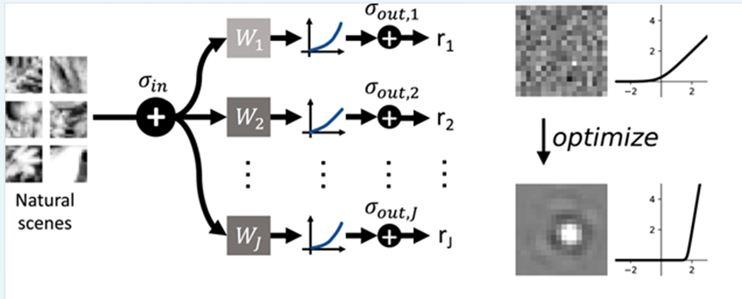
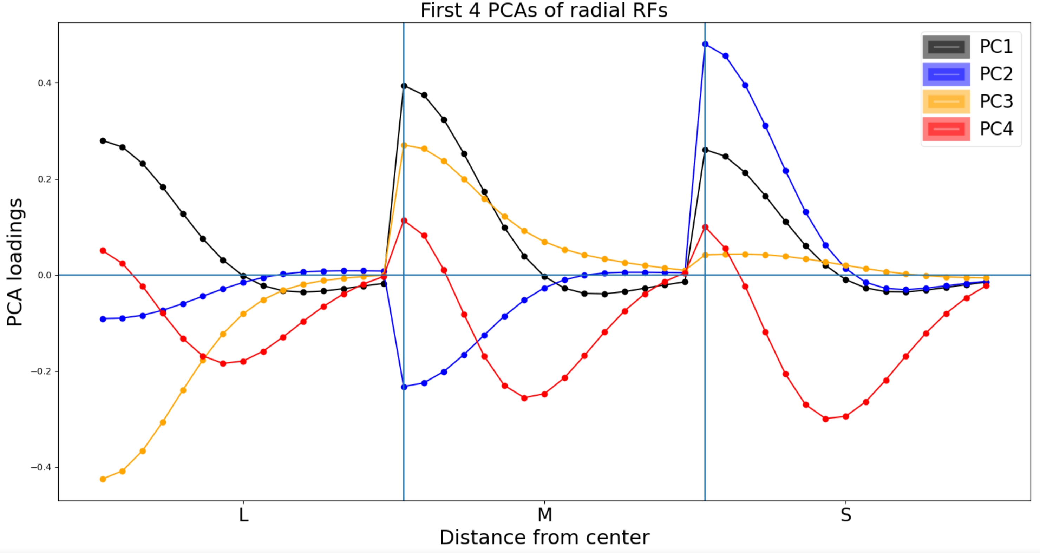
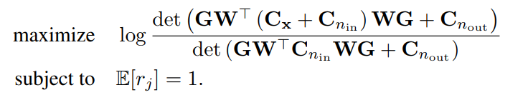

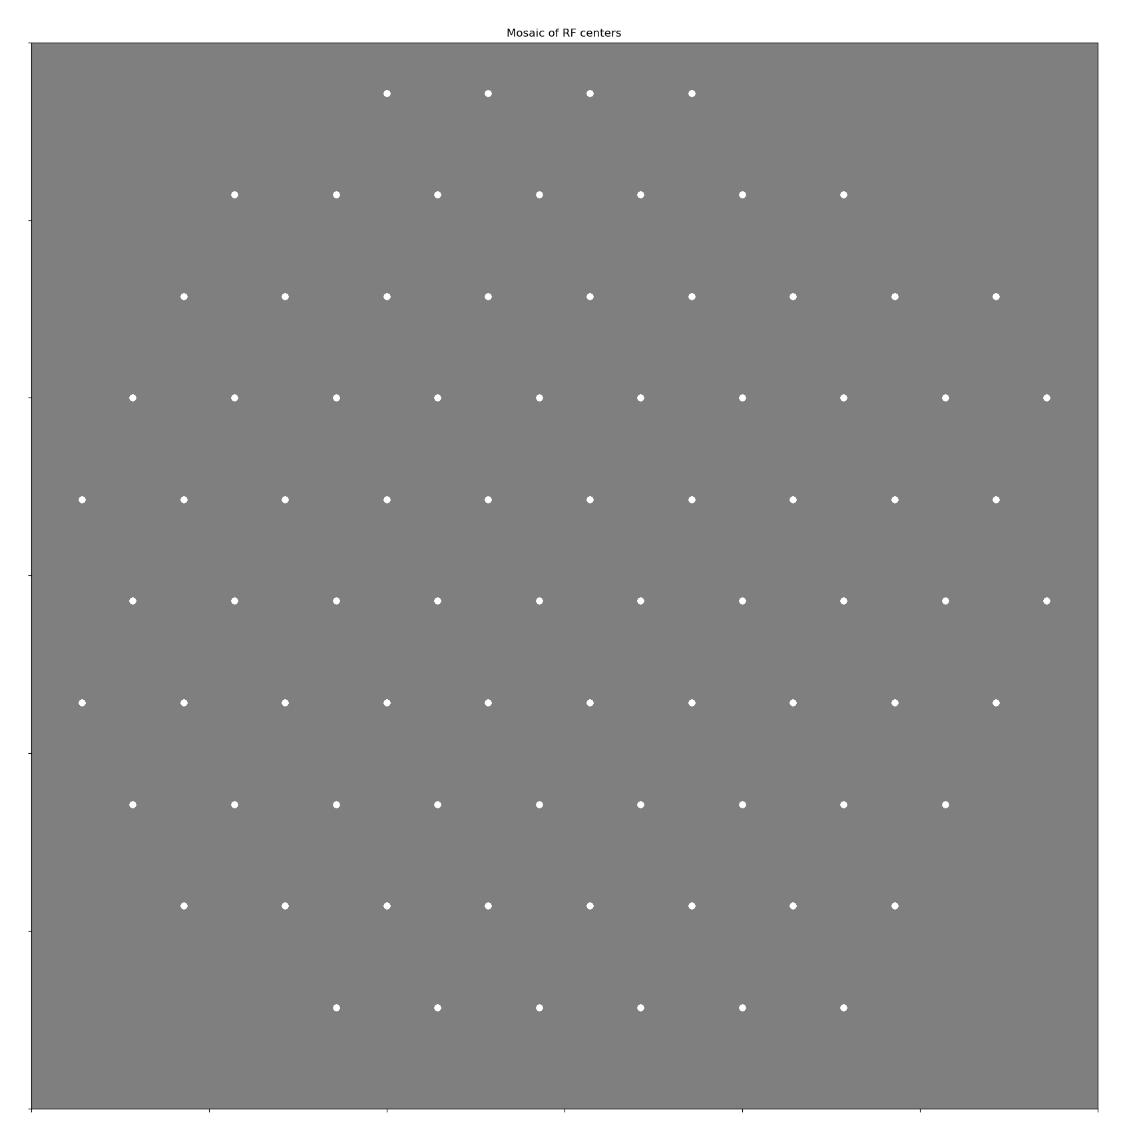
How to efficiently encode chromatic natural images in the retina
David St-Amand, Greg Field and John Pearson
Pearson Lab, Neurobiology Department, Duke University, Durham, NC, USA
Introduction
Results
Discussion
Efficient coding: Sensory systems should efficiently encode their inputs, e.g.:
1. Maximize mutual information: I(X;Y) = H(Y) – H(Y|X)
2. Under a firing rate constraint: E[r_j] = 1
Efficient coding models has been very successful at explaining how the retina encodes (black and white) natural images (Jun et al., 2021)
However, the efficient strategy to encode chromatic inputs is less well understood
Example neurons
Fovea vs Periphery: Midget cells encode L vs M opponency in the fovea, but not in the periphery. Periphery has L + M center and – L – M surround, similar to findings here.
We also get blue/yellow opponency
Distribution of d parameter
Methods
Conclusion
Efficient coding model:
Principal components analysis of receptive fields
Training objective:
Parametrized Difference of Gaussian:
W = d*(e^(-a*z) - c*(e^(-b*z))
Model parameters:
12x12x3 inputs
500 neurons

